Slide 1

Tyro Data Eliding(Obfuscation)
using MySQL triggers

Slide 2
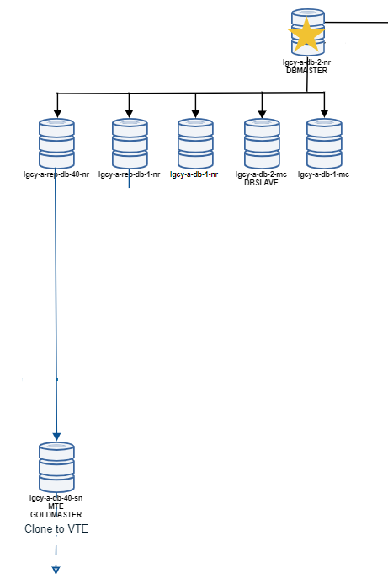
Basic Data Flow
Less Elided
More Eliding

Slide 3
Important things to note about MySQL triggers
The Create Trigger is replicated over to it’s slave.
For Statement-based binary log format;
Trigger needs to be present on both Master and Slave.
The trigger on the slave is invoked.
For Row-based binary log format;
Trigger only needs to be present on the Master.
The data updated by the trigger is replicated over to it’s slave.
We use Mixed binary log format.

Slide 4
TYRO Trigger creation
In Legacy cluster, we have two REP hosts.
From REP hosts level, binary logging is in ROW format.
lgcy-a-rep-db-1-nr, lgcy-b-rep-db-1-nr
Less triggers
To help engineers in debugging
sqlrevolve & sqlshadow are cloned from a slave with less eliding.
lgcy-a-rep-db-40-nr, lgcy-b-rep-db-40-mc
More triggers
Used to create VTE’s

Slide 5
Trigger and Eliding related alerts
mysql_triggers_md5sum
To ensure that all the expected triggers are present on the DBHost
mysql_check_unelided_data
To check if any new column has been added that matches a list of possible sensitive data column names (eg: name, birth, address etc)
mysql_check_trigger_eliding
It check the last 5 rows from the table whether it is elided.
This check relies on the existing triggers on the host.
It checks if the action in the trigger body matches the data.

